Slide 1

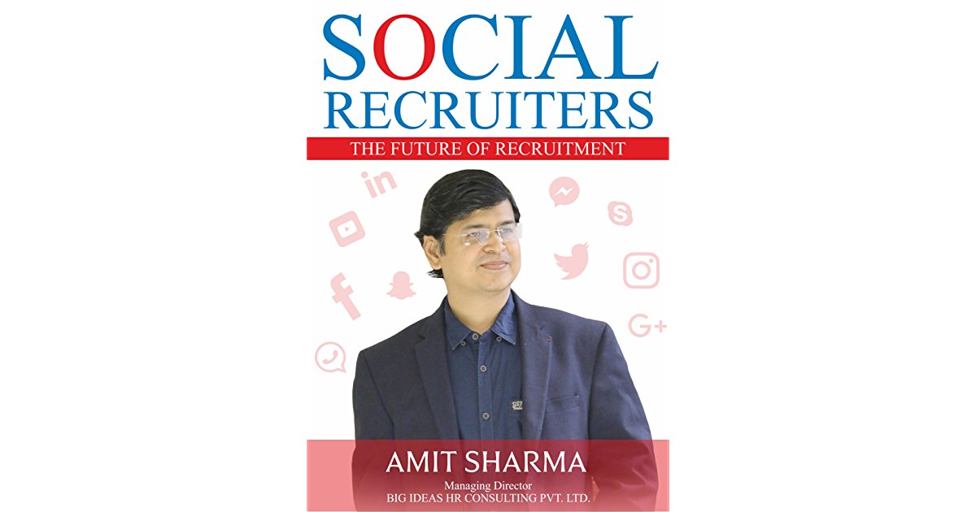
SOCIAL
RECRUITER
THE FUTURE OF RECRUITMENT

Slide 2


History of Recruitment
As a general concept, recruitment can be traced back to around 55 BC, when Julius Caesar effectively introduced the first referral programme for soldiers who brought other soldiers into the Roman Army. The reward by Caesar amounted to 30% of a soldier’s annual pay, making it a massive windfall for those who took him up on it.
Romans recruitment standards were very high and had a very specific Job description like the candidate must be a roman citizen must be capable to walk 20 miles with weapons.
Later on roman army promoted Equal Employment opportunity for people and removed class structure and also started promoting its employer brand with a golden eagle which was the logo of the army. Even today it is relevant when companies promote their brand.
Around 50 B.C loyalty of the soldier was moved from Rome bureaucrats to Army commanders which made the whole recruitment process smooth as the commanders could hire locally and that made recruitment faster.
Interestingly, World‘s first recruitment agency was started by Henry Robinson in the year 1653. After this historical event, it led to creating of a whole new industry which we know today as Recruitment Industry which is now 400+ years old. Who would have imagined that this move can create an industry worth 500+ Billion Dollar.

Slide 3
BIRTH & EVOLUTION OF
RECRUITMENT AGENCY: World War II to 2004
During the outbreak of World War II, recruitment as an industry took birth as a huge number of soldiers were to be recruited.
1960-1970‘s, recruitment agencies started moving out of UK to other locations in Europe to expanded global operations.
Till late 1980‘s things were the same in terms of how recruiters operated where they were majorly focused through telephone, fax and we did not have email communication. The only way to do recruitment was through conventional means of advertisement in newspapers.
Recruitment agencies steadily thrived and evolved into headhunting operations
Sometime in the 1990‘s, the Internet boom created jobs for systems analysts, programmers, coders and software & hardware engineers. With these new jobs came the slow but steady trickle of online recruiters.
Between 1990‘s till 2004, it was a period of Job Boards and ATS with an objective to make whole recruitment process effective and this was the phase of early digital revolution with more and more companies getting to online search and posting of jobs.

Slide 4

FUTURE of Recruitment
In early 2000s, with the rise of social networks like LinkedIn that allow you to link with the personal and professional acquaintances of your network, the digital era has made job hunting easy and convenient today.
Between the years 2005 - 2014 the game of recruitment was just changed with professional networking platforms expanded its reach like never before, coupled with other social platforms like Facebook recruitment became a very different ball game for recruiters which called for mind-set and Skill development.
Cloud based platforms combining various elements like ATS and Social Media tools, a Post recruitment Analysis software would give more accurate understanding of Return on Investment (ROI) for each recruitment that happens.
The last two decades have seen social media explode, heralding in a new way of networking and communicating professionally. Sites such as LinkedIn, Twitter and even Facebook have all helped to bolster the recruitment sphere, giving professionals and recruiters worldwide instant access to an infinite amount of information and resources. Passive targets became easier to target through these social networks, but they also blurred the line between candidates’ professional and personal lives.

Slide 5
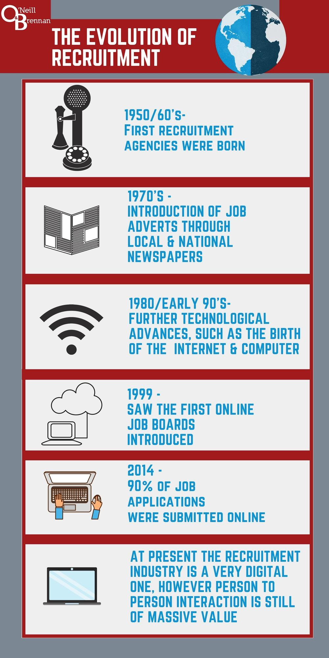

CONVENTIONAL MODEL – CONTEMPORARY MODEL

Slide 6
What is Recruitment?
Recruitment is the process of finding and hiring the best-qualified candidate – from within or outside of an organization – for a job opening, in a timely and cost effective manner. The recruitment process includes analysing the requirements of a job, attracting employees to that job, screening and selecting applicants, hiring and integrating the new employee to the organization. (Source: Business Dictionary)
Process of End-End Recruitment
Need Analysis
Sourcing
Hiring
Need Analysis
Internal
Sourcing
External
Sourcing

Slide 7
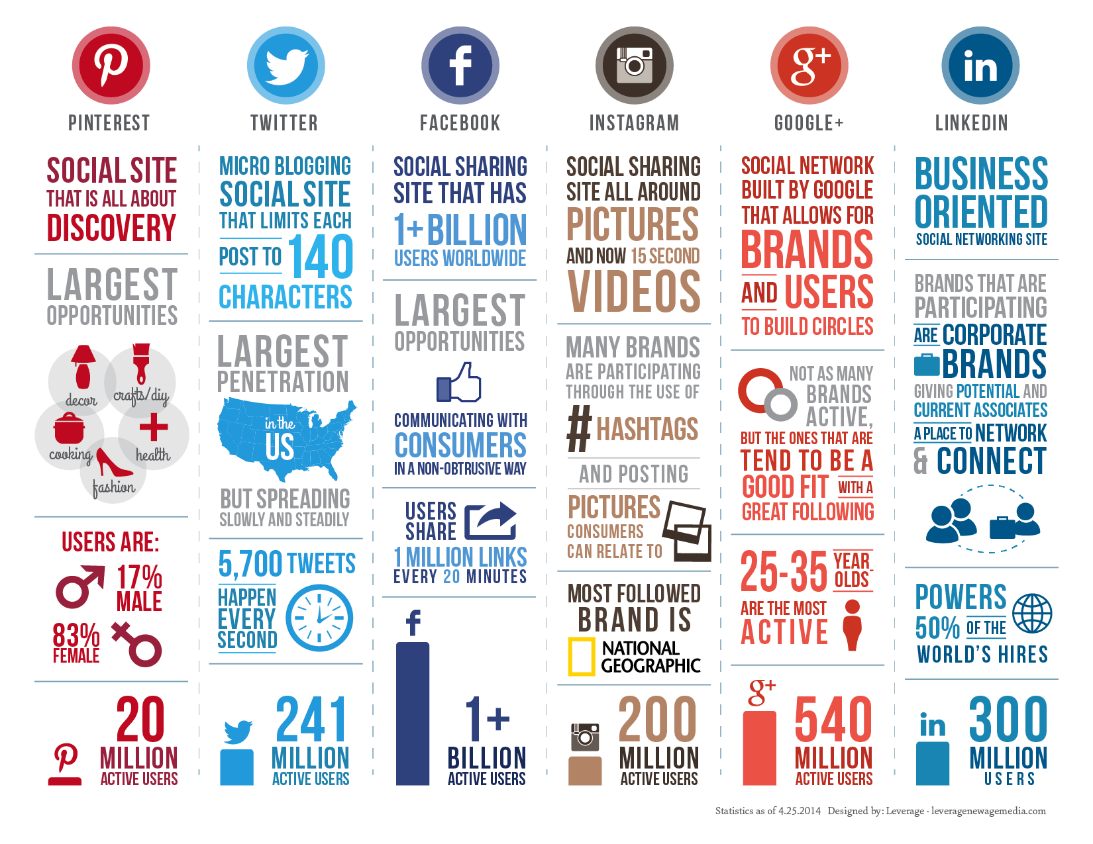
What is social media
Social media is a web based technology to create and share information, content, ideas and opinion through various social Communities and social network online. Social Media is driven by user generated content; people are connected through individual or groups social networks.
On Social media information is shared through Internet or mobile phone based applications through social networking sites like Facebook, LinkedIn, Twitter, etc. and also through bookmarking sites like Reddit. Also, blogging platforms are being used to engage in conversation with others by posting articles, news and on-going events. It is also used by friends and families to stay connected.
Image Source: http://insideleft.co.uk/content/uploads/sites/3/2014/05/Social-infographic_2014.png

Slide 8
Positives and Negatives of Social Media
POSITIVES
NEGATIVES
It is fastest way to connect with billions of user which is just mind boggling.
Increasing traffic to you website for faster reach to target audience.
Building relationships, 84% of world‘s top fortune 500 companies are on twitter.
Documenting memories learn from others.
Everyone can be a content creator.
You can impact society and people around you positively.
Social media need constant time and effort to be active on it.
Cannot control on what people can say and express views towards you and your views.
Can help Anti-social elements to leverage it for their benefit.
Data theft is a big danger. It can cost huge damage to business.
Cannot take a break as it is not one time engagement.

Slide 9
Defining Social Media Recruitment
Social recruiting (social hiring or social media recruitment) is recruiting candidates by using social platforms as talent databases or for advertising. Social recruiting uses social media profiles, blogs, and other Internet sites to find information on candidates. (Source: Wikipedia).
Social media has become a huge game changer in the world of recruitment. Websites and applications like LinkedIn, Facebook, Google, XING, twitter, Instagram and the likes have cropped up in the past few years and changed the world of online recruitment.
A Brave New Social Media Recruiting World
So at this intersection of social media and recruitment, head-hunters are accessing different social media profiles and online communities to find the right candidates. Remember we talked in the first Chapter about using innovative methods to reach skilled talent in a field that may not have as many experts? Social media recruitment directly addresses the challenge of accessing people that may not be actively seeking a job. Let us look in detail as to how social media helps recruiters‘ access passive job seekers with a good skill set.
We already know about one aspect of social media that allows recruiters to access skilled professional‘s profiles on platforms like LinkedIn and Facebook and other social platforms. This is where the recruiter is actively looking for potentially viable candidates who have posted their information on social networks.
As you can see, the rapid evolution of social media in the last decade means that recruiters have widely and quickly adopted social technology for their recruitment purposes.

Slide 10
How recruiters are benefitting from social media?
  A lot of these corporate recruitment tools are free or nominally charged.
  Often, social media is a sure fire way to research the market and reach out to candidates and clients outside of your usual networking circles.
  It provides a way to reach out to skilled candidates who may not be actively looking for a job but are a good fit for the organization.
  It allows you to leverage existing contacts in your social network such as former clients, co-workers, industry experts, entrepreneurs and even public figures and mine their friend lists for quality candidates.
  Makes it easy to know a candidate‘s qualifications before you even spend further time or money meeting or getting to know them.
  Helps weed out candidates that are not such a good fit for the job opening/company culture.
  Saves a lot of time sifting through piles and piles of resumes only to rule the candidate out as soon as you interview them.
  Online and video interviews allow recruiters to gauge the viability of a candidate for a position even before spending any money on travel costs.
  It makes social recommendations very easy. Say for example if you work for a company which is hiring a social media analyst. You tell your content developer friend about it by tagging them in a social media post. Your friend shares it on his/her profile and someone used to work with sees your post and applies for the job. Voila! Recruitment made easy.
  Social media helps recruiters create cheap and highly targeted advertisements to target specific professional audiences.

Slide 11
What are the Pitfalls using Social Media for Recruitment?
  A lot of experts criticize social recruiting because you're just using the general public forum to source a job candidate.
  Lack of technical and social media savvy among experienced recruiters of the baby boomer generation.
  Lack of guidelines and industry norms in the field of social media recruitment as it is a relatively new field of work.
  Presence of ethical grey areas that can lead to misunderstanding on both the candidate and recruiter‘s side.
  Not always a purposeful engagement you may or may not get some good results out of it.
  Sometimes people can misrepresent their experience or skills.
  Otherwise good candidates can be disregarded due to content on their social media profiles.
  Let‘s take a deeper look at that last problem in further detail: In 2013, an organization named ―On Device Research‖ surveyed a huge population sample of 17,000 young people in six countries. The results of the study indicated that nearly 1 in 10 youth
  between 16 and 34 get rejected from potential jobs because of comments they have made on social platforms!
  In fact, a social recruiting survey by popular portal Jobvite the following year indicated that 93% of recruiters check candidates' social media postings as part of the screening process.
  As you can see, social profiling is real and very powerful. If used wisely and with discretion, it can be an efficient tool to weed out inappropriate hires. However, if used incorrectly, it can blow up in a candidate, recruiter or hiring organization‘s face, so to speak!

Slide 12
How do we know social media recruitment works?
  As a social media recruiter juggles postings on social media, job portals, referrals, employee exchanges, recruiting tools and consulting vendors through his/her ability to recruit through use of social media, navigate all social media avenues, and knows how to maximize recruitment through those sources - the question remains - how do you really know if you are getting back more than you are putting in?
  However, this ROI is ever so tricky to measure because even though they may see the posting online, applicants don‘t normally apply through these social media platforms. One tool that has been helpful in tracking effectiveness of recruitment online is the Social Recruitment Monitor by the Maximum Employment Marketing Group. The social recruitment monitor ranks the reach, engagement, and interactivity of employers' social recruiting efforts around the world. However, like many aspects of social platforms today, the concrete ROI will be difficult to calculate as social media is still in its early years and rapidly evolving. As such, any online
  recruiting efforts should be done as a way to reach appropriate candidate audiences but without the expectation of instant, measurable returns.

Slide 13
Who is a Recruiter
  Recruiters will work from resumes or by actively soliciting individuals qualified for positions. A Recruiter's job includes reviewing candidate's job experiences, negotiating salaries, and placing candidates in agreeable employment positions. (Source: Business Dictionary).
Difference between a Recruiter and Human Resource Professional
Human Resource Professional
Human Resource professionals act as a bridge between an employee and an organisation. They take care of an organisation‘s interest. They handle all human resource management which can broadly fall into recruitment, training, coaching, compensation & benefits, employee relationship, HR compliance and grievance management. For an HR guy, recruitment could be one of the responsibilities. They get involved right from on boarding and induction of the new people. They look after training, coaching, Performance Management (PMS) etc. They also contribute in compensation strategies to remain competitive in market place. Work on setting up systems and processes.
Role of a Recruiter
The major role of a recruiter is to facilitate the whole process of recruitment between a candidate and the organisation which is hiring a candidate. Without recruiter the whole process of recruitment does not move further. Recruiter‘s role is to identify various sources to find candidates resumes, do pre-screening and conduct first round of interview and evaluation His role is to also to make potential candidates by selling the USPs of job and the companies and ask as a brand manager for the company. With Social media the role of recruiters has also changed greatly. The role of a recruiter is also to find best talent available in the market for his or hers client. Also he has to connect with candidates at personal and emotional level to ensure joining.

Slide 14
Who is a Social Recruiter
  Social Recruiter is one who uses his or hers social skills through social media platforms, social Networking to facilitate hiring suitable candidates for a desired job profile.
  Using the principles of recruitment in a social cause for social upliftment is a highly innovative idea that has not been discussed or used anywhere else in India today.
Must Have for Social Recruiters
SOCIAL RECRUITERS
Use social strategies for Hiring Star Talent through Social Platforms
Leverage different Social Platforms
Out-of-the-box thinking
Use Social Recruitment Tools Effectively

Slide 15
Qualities / Skills of a Successful Social Recruiters
Personal Traits
Approachability
Stellar Social Skills
Ability to persuade
Good judgment
Ability to sort priorities
Solid follow-up
Honesty and Ethical behaviour
Strong Emotional Quotient
Transferable Traits
Interpersonal skills
Ability to listen
Relationship building
Teamwork
Communication
Sales and Marketing Skills
Branding Skills
Social Media Skills
Organizational skills

Slide 16
Understanding Social Platforms & Tools and Techniques
Social Platforms
  Social platforms are social networking websites, through which stay connected and increase their social and professional network. With different features, purposes and functionalities there are many different types of Social Platforms.
  For Example, Facebook is a networking platform for staying connected primarily with friends and relatives and LinkedIn is a networking platform for staying connected with professional network.
  Every individual platform has its rules, recruitment strategies and best practice guidelines. So, a strategy that works beautifully on LinkedIn or Twitter may not give you much engagement when applied on Pinterest or Instagram.
Tools and Techniques
  Each platform should be strategically utilized through various tools and techniques to get the best result. Hence based on each of the major platforms we have various tools and techniques that you can use to reach out to quality candidates, so that they may be more receptive in responding and you can start establishing rapport with them with the very first conversation.
  Also, we should bear in mind that tools are not just limited to technology and gadgets alone. Any system of thought or any useful product, service or technology that can leverage a recruiter in their quest for superior talent is considered as a tool for the recruitment to trade.

Slide 17


Major Social Platforms for Recruiters
What | A social media website first developed by Mark Zuckerberg while he was a student at Harvard in 2004. Since its creation it has become one of the most popular social media sites attracting people of all ages from all over the world. 1.35+ Billion active users – worldwide and 100+ million Facebook users in India. Users may join common-interest user groups, organized by workplace, school or college, or other characteristics, and categorize their friends into lists.
Why | 100 Million Indian Members, > 1 Billion Global Users. Second Most trafficked website globally. 1 in 5 Job Seekers added Job info last year. 1 in every 13 people on Earth is on Facebook. People that use Facebook on their mobile devices are twice as active on Facebook than non-mobile users.
What | LinkedIn is your virtual introduction to a network of professionals from around the globe. A new member joins approximately every second, it lends the perfect opportunity to search for, make introductions to, and collaborate with potential clients and business associates.
Why | Biggest Professional Social Networking Site 364+ million members in 200 countries 93+ Million Members in US (with 29.90% Penetration) 24+ Million Members in India (with 2.02% Penetration) A new member joins approximately every second, it lends the perfect opportunity to search for, make introductions to, and collaborate with potential clients and business associates.

Slide 18

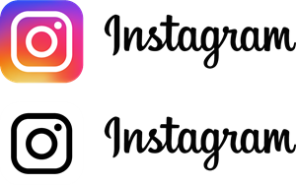
Major Social Platforms for Recruiters
What | Twitter has a unique concept of micro-blogging that allows members to broadcast short posts (140 characters) called tweets. (#) Hashtags are used in Tweets to reach the target audience.
Why | 302+ million registered users (May 2015) Tweets have a 12x higher chance of being retweeted. 86% of twitter followers are more likely to buy from you if someone recommends you on twitter. 73% of twitter followers follow companies on twitter to keep up to date with new products/services and are more likely to be the first to buy them and the same applies for Recruitment.
What | Instagram helps, take pictures, videos or compile short ―stories‖ and share them with your followers. Whatever feature you use, Instagram is great for building personal connections with candidates.
Why | It is a great tool for Personal branding for potential candidates and also for employers. 300 million active users each month. 70 million photos uploaded each day. The average user spends 257 minutes per month on the app. 2.5 billion photos liked each day.

Slide 19


Major Social Platforms for Recruiters
What | YouTube is an online public communications site where videos are shared. Users can create their own accounts where they can upload, view, share videos and comment on them.
Why | 490 million users worldwide. The longest Video ever on YouTube is 48 hours (2 days!). It generates an estimated 92 billion page views each month. Together, we spend 2.9 billion hours on YouTube in a month. That’s 326,294 years. YouTube is localized in 25 countries across 43 languages. Millions of videos are considered favourites every day.
Google+
What | Social networking and identity service owned and operated by Google Inc. "Circles" enable users to organize people into groups for sharing "Hangouts" are places used to facilitate group video chat (with a maximum of 10 people Follow for Pages and Add for People
Why | Follow for Pages and Add for People 359+ Million active users You can search for your classmates and follow them. Can search people, company, etc

Slide 20
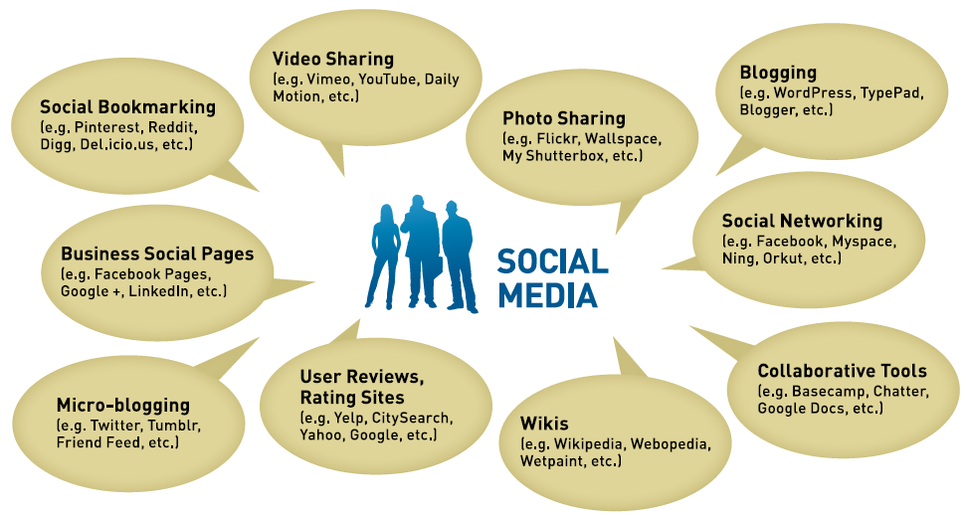
Social recruitment tools and techniques
Tools and Techniques help handling social media gets easier and helps you reach your specific goals.
For better understanding and applicability we have divided the Tools and Techniques into two groups:
Social Platform focused Tools & Techniques.
Purpose focused Social Tools and Techniques.
Image Source: https://www.ontario.ca/page/social-media-small-business

Slide 21
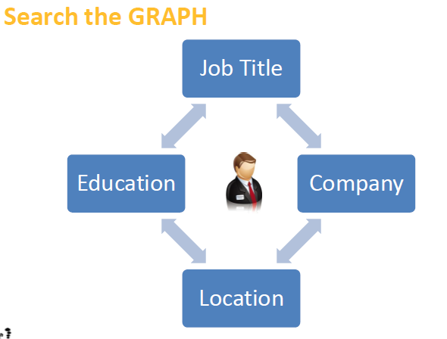
  Social Platform Focused Tools and Techniques
Facebook Graph Search
Semantic search engine
Introduced by Facebook in March 2013.
Designed to give answers to user natural language queries rather than a list of links.
Combines the big data acquired from its over one billion users and external data into a search engine providing user-specific search results.
No Boolean. Basic ‘natural language’ commands

Slide 22
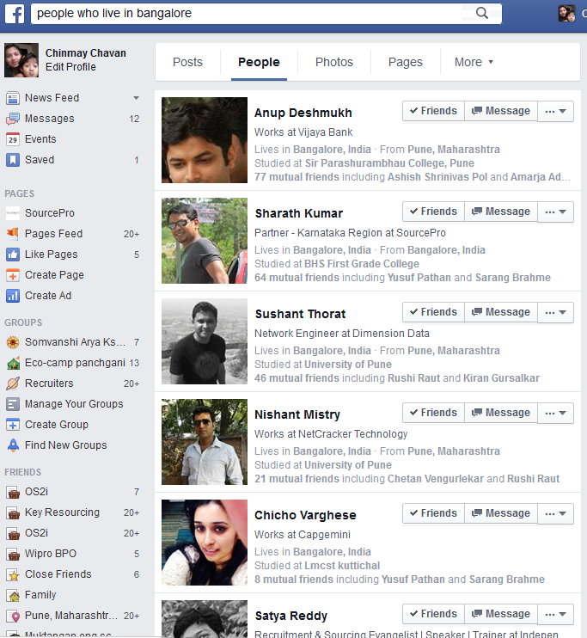
People from specific Location

Slide 23
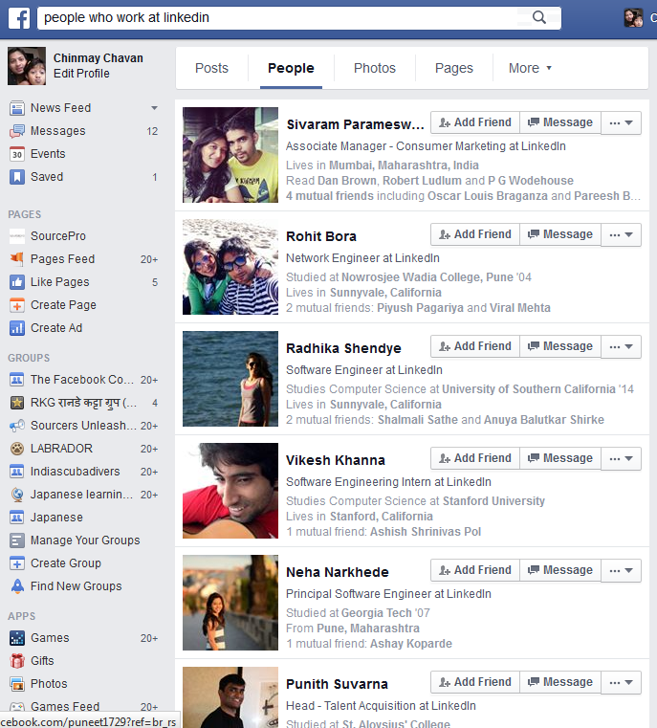
People from target companies

Slide 24
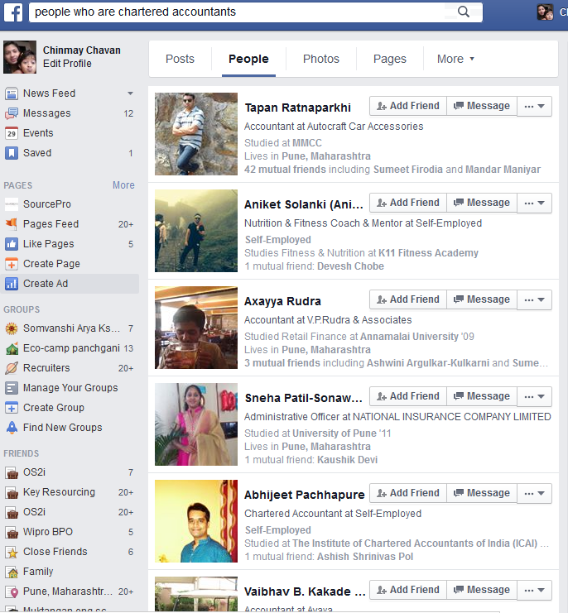
Job Title based search

Slide 25
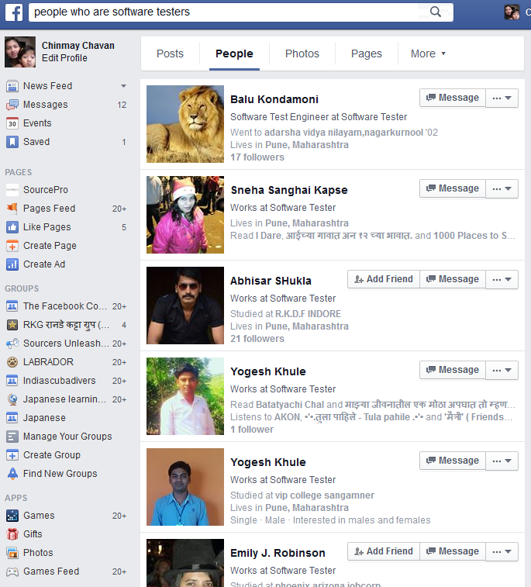
Search by job title

Slide 26
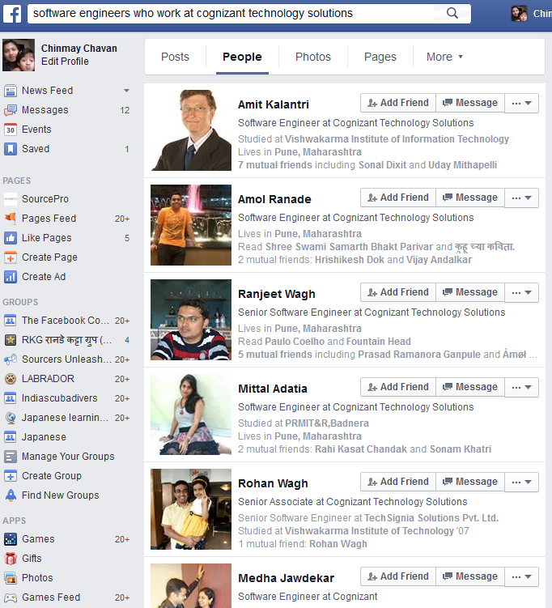
Job Title Searches from Target Companies

Slide 27
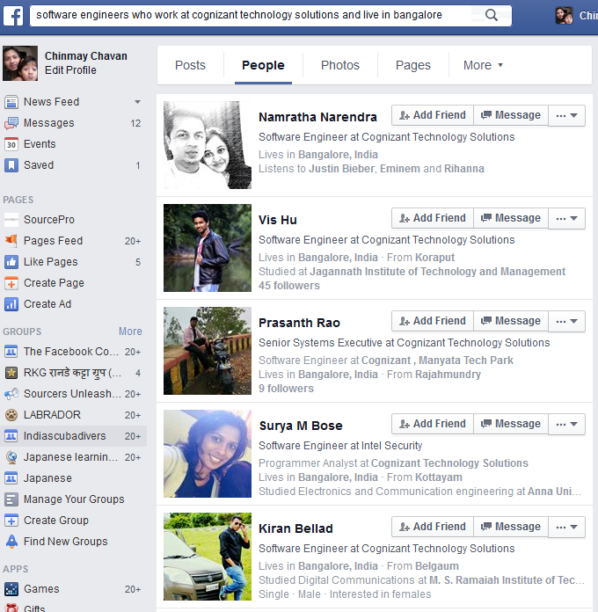
Job Title Searches from Target Companies

Slide 28
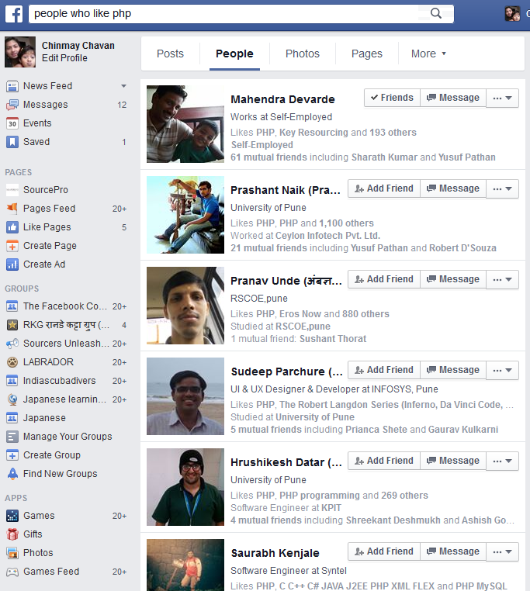
Searches based on ‘Likes’

Slide 29
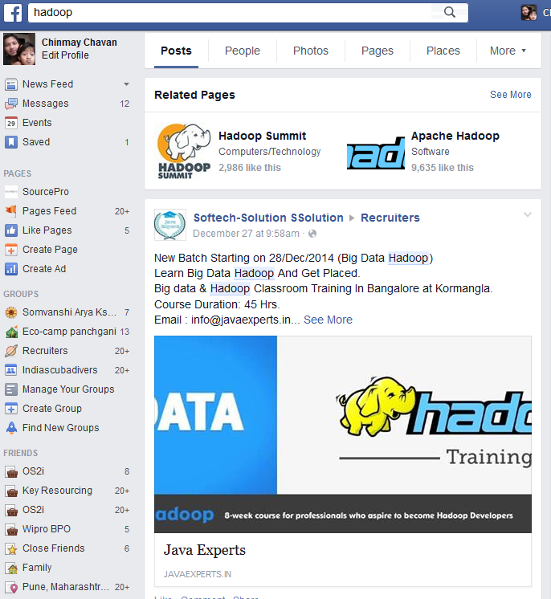
Topic Based Search

Slide 30
Searching people within Groups
Graph search allows you to search for people within mentioned groups; even if you are not a part of those groups.

Slide 31
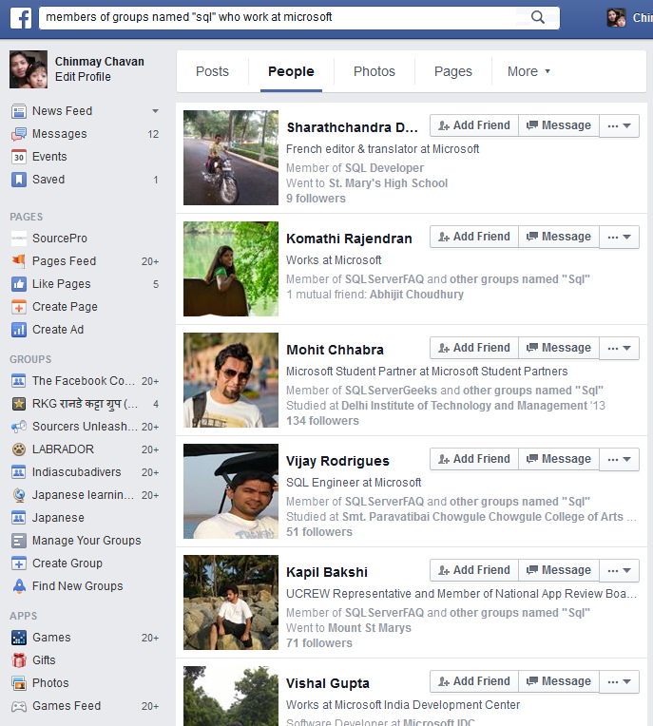
members of groups named "sql" who work at microsoft

Slide 32
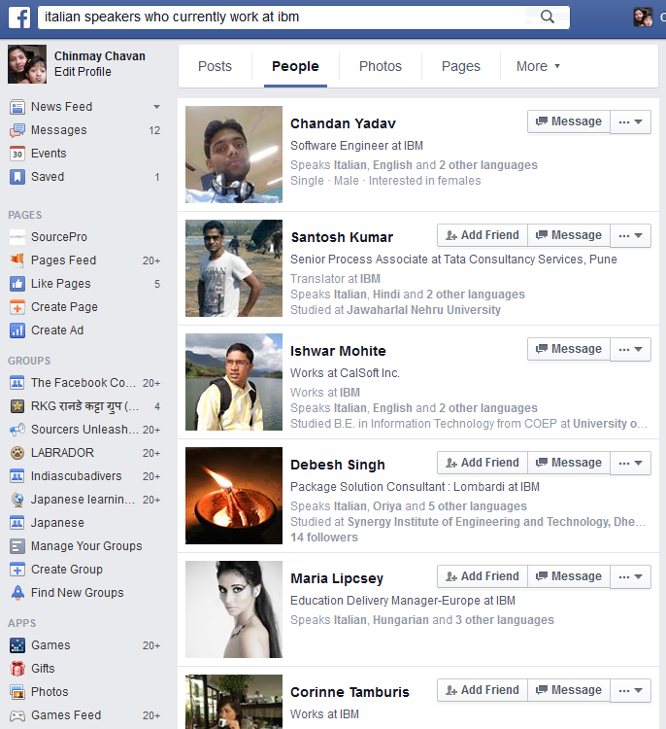
Language Speakers

Slide 33
Graph Search Variables
People who are
People who work at
People who live in
People who like
People who speak
People who majored in
Members of groups named “keyword“

Slide 34
Things to Remember
Don’t compare it with Linkedin or any other Job Portal. Its just another possible tool for recruitment.
Designation search is not very flexible. We have to use pre-defined Job Titles. It does not support variants. For E.g. Only the keyword “software” wont work, it has to be “software Engineer” or “software developer” etc.
Multiple filters cannot be used at once. You will need to change keywords to use different job Titles. Searches for designation like HR Manager will have to be run as “HR manager” & “Human resource Manager” separately as it does not support Booleans so combinations are not possible.
There are many filters available, not all can be used for recruitment.

Slide 35
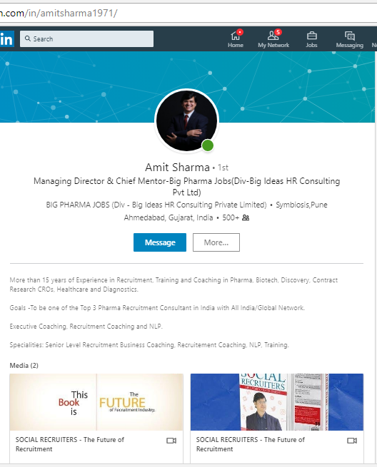
LinkedIn Profile
Your profile is your own brand image in your professional life
Visitor can get a rich and detailed idea of all the skills, experiences, and interests
Can mention:
  Lists of groups you belong to
  Memberships or affiliations you have
  Honors and awards you have received
  Professional interests.
  Presentations for others to view
  Website link to other parts of your professional identity

Slide 36
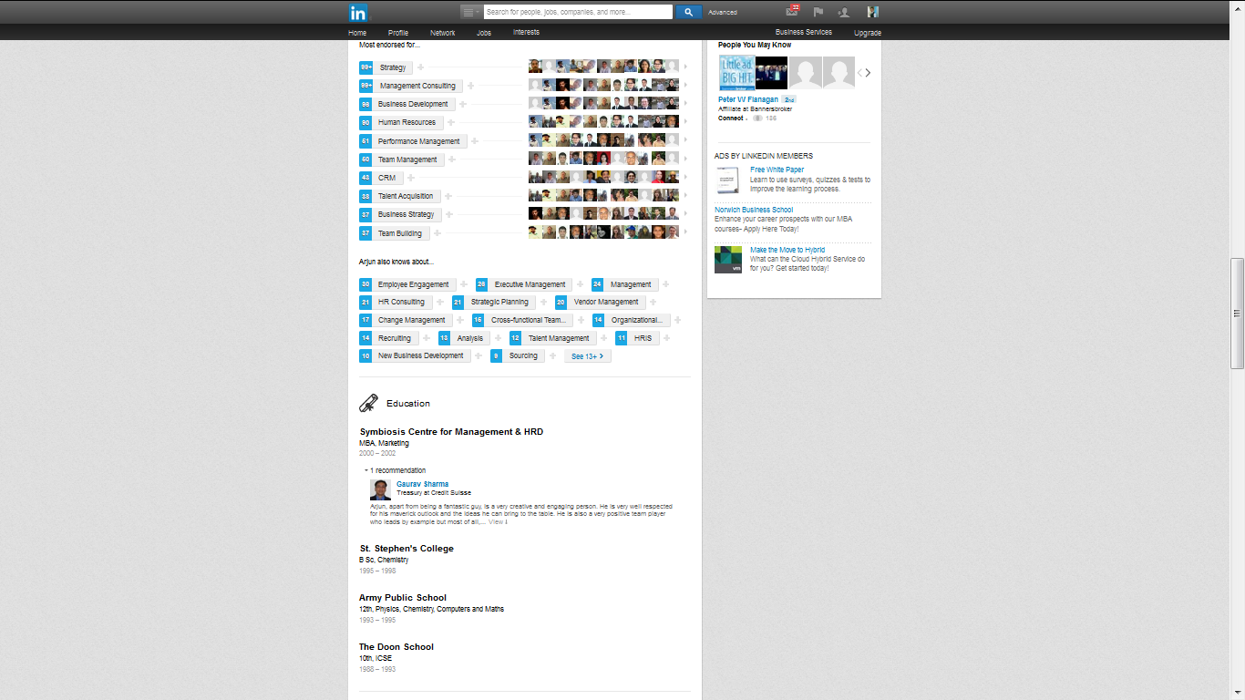
LinkedIn Profile
Build your Profile
Cover
Photo
Profile
Photo
Skills
Summary
In Media, Multiple PPT, Videos, Documents, etc can be added (Uploaded)
Education

Slide 37
LinkedIn Connections Structure
Out of Network
3rd Degree
Out of Network
2nd Degree
3rd Degree
You
1st Degree
2nd Degree
Out of Network
3rd Degree
Group Member
3rd Degree

Slide 38




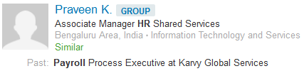
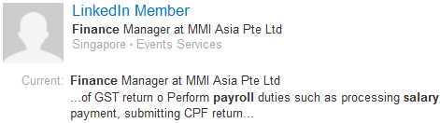
LinkedIn Connections
1st Degree – Contacts which you voluntary add.
2st Degree – 1st degrees of your 1st degree connection.
3rd Degree – 1st degree of your 2nd degree connection or 2nd degrees of your 1st degree connection.
Group Member – Linkedin searches Group Members from joined groups. (May or may not be your 1st, 2nd or 3rd degree connection)
LinkedIn Member – Out of Network. People who are not in your network at all.

Slide 39
LinkedIn Advanced Search
Allows you to search for people, jobs, companies, groups, and more.
Can use advanced search operators and Boolean logic to conduct searches.
Can use the LinkedIn Filters to search.
Relationship, Location, Company, LinkedIn Industry, LinkedIn Groups, Function, Company Size, etc. filters can be used to get more specific profiles.

Slide 40
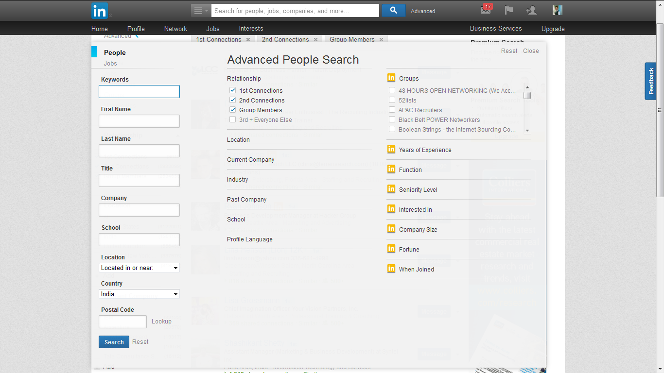
Advanced People Search
Advance Search Filters
Boolean Syntax
The results are the same for all accounts

Slide 41
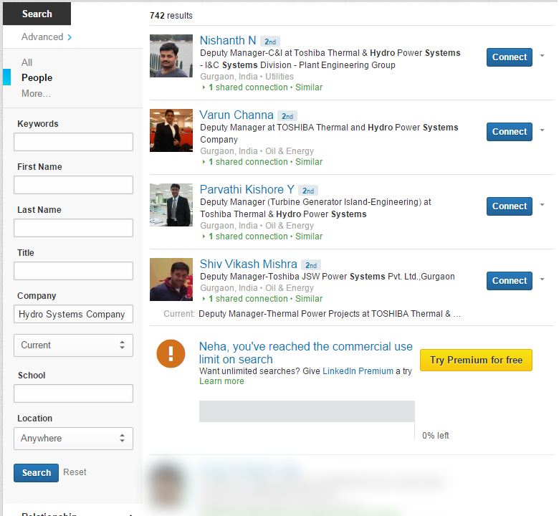
Commercial Use Limit on Search
Limit is calculated based on your search activity since the first of the calendar month.
Progress bar will appear in your search results when 30% of your searches are left, and will continue to remind you in 5% increments
After you've reached the limit, you'll continue to be able to search, but will see a limited number of results.
Your free monthly usage will reset on the 1st of each calendar month.
Need to upgrade to LinkedIn Premium Accounts for unlimited searches or wait for the limit to reset at the beginning of the month

Slide 42

Linkedin Groups

Slide 43
Linkedin Groups
Virtual message board or forum
Post comments, links, or articles, and ask questions
Network with other individuals who have your same passions and/or affiliations
Join Groups of your Interests or your college or university
Wide variety of groups to join or create a new one!

Slide 44
Linkedin Groups
Why Should I Join a LinkedIn Group?
Conversation starters
Allow you to follow top influencers in your field or niche
Source & Recruit!!!
Get ideas & answers to your very own questions!
Great way to network

Slide 45
Company Search
3,244,156+ registered companies
Search for companies by attributes such as location, industry, and size as well as how you are connected
Filter a set of results to include only those companies where you have a direct connection or broaden your search to include companies in your extended network.
Results are personalized based on keywords used in your search, filters you have applied, your overall connection strength to that company, etc.
Companies may have duplicates – like Vodafone, Vodafone UK, Vodafone Ireland, etc

Slide 46
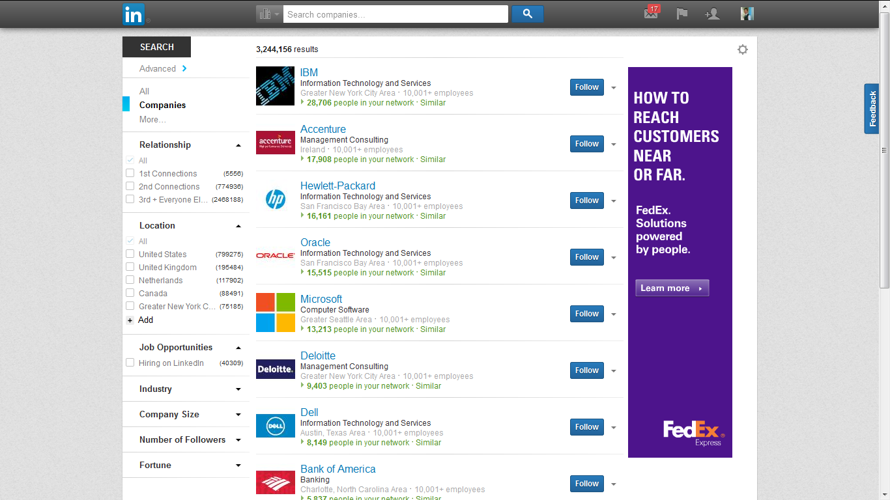
Company Search Homepage
Filters To Get Appropriate Results

Slide 47




LinkedIn InMails
InMail: The most credible way to message anyone on LinkedIn
Message any of the 364 million+ people on LinkedIn.
InMail protects every user’s privacy
What is InMail?
Reach any LinkedIn user
InMails are private messages that let you send business and career opportunities directly to any LinkedIn user.
InMail allows you to contact or be directly contacted by 2nd or 3rd degree contacts as well as LinkedIn users who are not in your network.
If a recipient is not in the sender’s network, the sender will not see the recipient’s name or contact information until the InMail has been accepted.
InMail is a paid feature

Slide 48
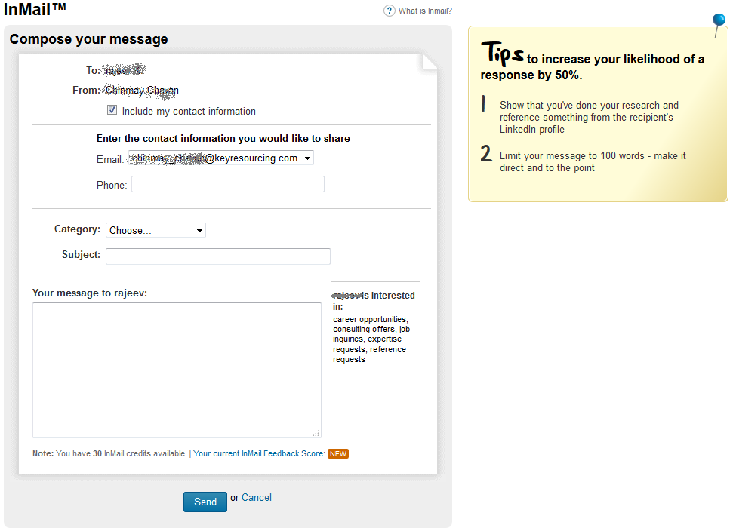
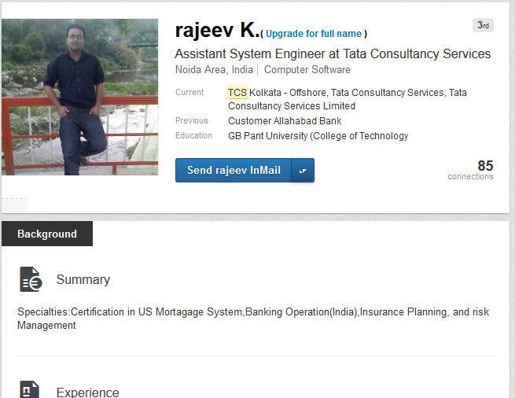
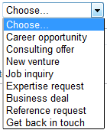
LinkedIn InMails

Slide 49
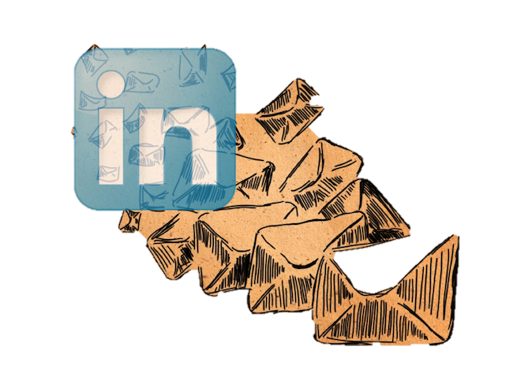
LinkedIn InMails
Why to use InMail?
Does it work?
How can it help?
To reach anyone on LinkedIn, no introduction or contact info required.
It's professional, credible outreach - with your LinkedIn profile attached.
InMails are effective & backed with a response guarantee. You get an InMail credit for every InMail message that receives a response within 90 days of the sent date.
Impress with InMail.
If you are seeking new opportunities, InMail helps you make the right impression, in front of the right people, at the right time.

Slide 50
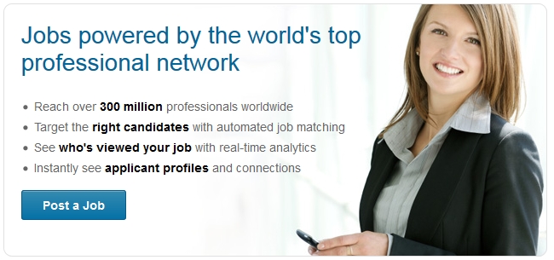
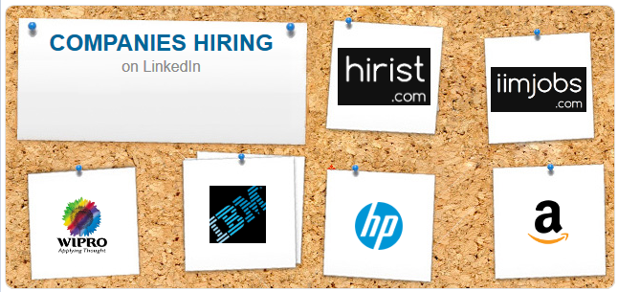
LinkedIn Job Posting

Slide 51
LinkedIn Job Posting
Why post jobs on LinkedIn?
World’s largest professional network
Provides you with ultimate talent pool to source the best candidates for your hiring needs
job posts are more relevant, personalized and targeted
reaching both active and passive candidates that are open to opportunities
Powered by LinkedIn’s social network
Can also have premium placements via sponsored jobs for your high priority opportunities

Slide 52
LinkedIn Job Posting
How do job postings work on LinkedIn?
Prices for job postings vary by location and include up to 24 free profile matches and 5 InMail messages.
Job postings automatically expire 30 days after they're posted. You can renew your job or close your job posting at any time before it expires.
Job postings can feature your company logo and link to your Company Page.
You can select to collect applicants through LinkedIn or an external website:
  Through LinkedIn - You can see statistics on who has applied and be notified by email when applications are received.
  Through external website or application tracking system - LinkedIn doesn't have access to applicant information.
  You can choose to make your job a sponsored job.
  After posting a job, you and your colleagues can share it with your networks on LinkedIn and other sites, and post it to groups where you're a member.

Slide 53
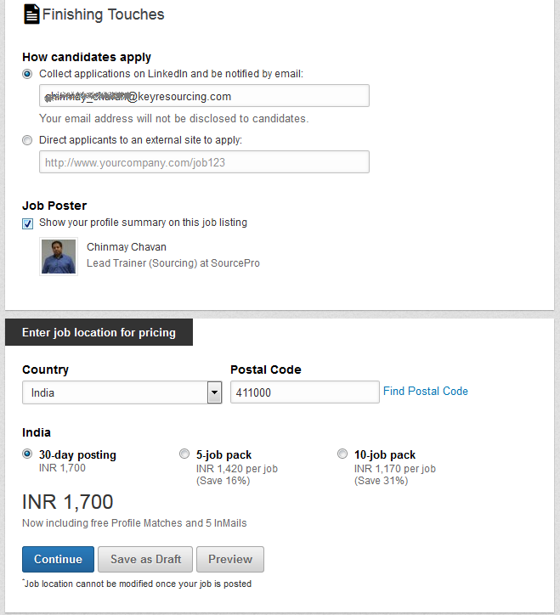
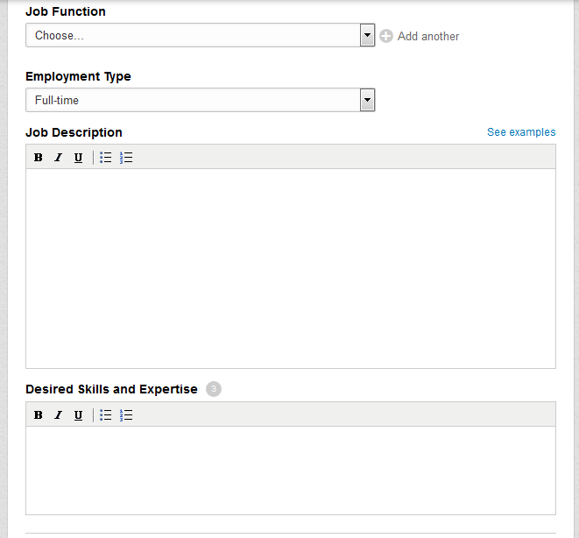
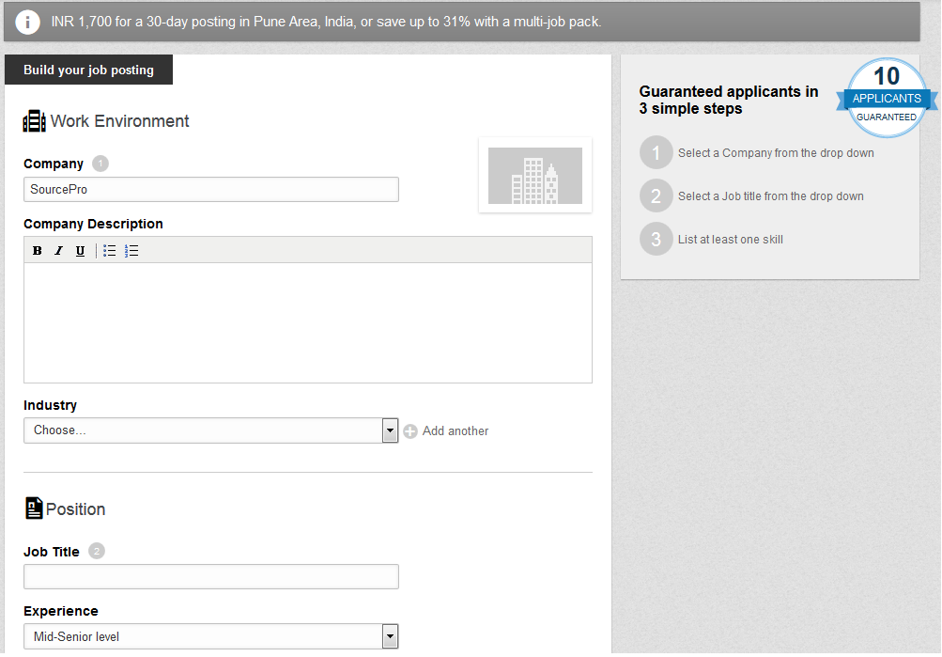
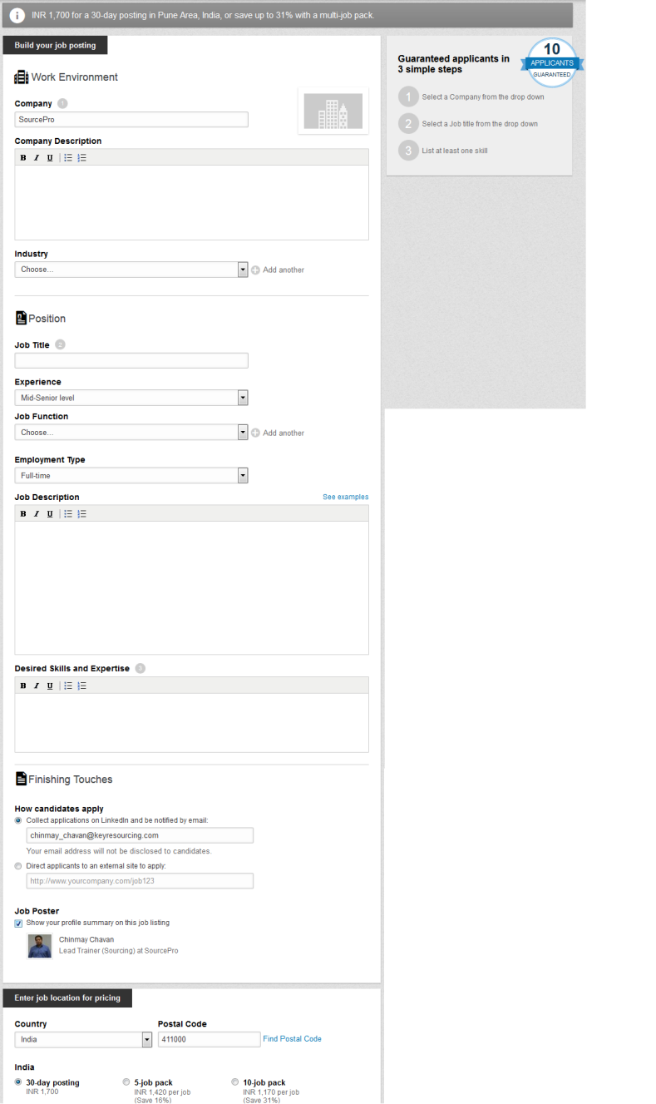
LinkedIn Job Posting

Slide 54
LinkedIn Job Posting
Post jobs differently
60% of professionals are open to job opportunities but not actively looking. Use Job Slots to share personalized job postings with members when they visit their home page, an employee profile, or your Career Page. Automatically target the most relevant candidates using LinkedIn’s matching algorithms and profile data. Posting jobs on LinkedIn leverages the power of our data combined with the social reach of our professional network.
Post jobs differently
Drive great candidates to your high priority roles with a Sponsored Jobs placement – the new and smarter way to post your jobs. Bid for premium placement of your roles in our personalized job recommendations.
Increase employee engagement with your job posts
Internal Job Recommendations surface your jobs to the right internal candidates, building awareness of internal opportunities and supporting your internal mobility efforts.

Slide 55
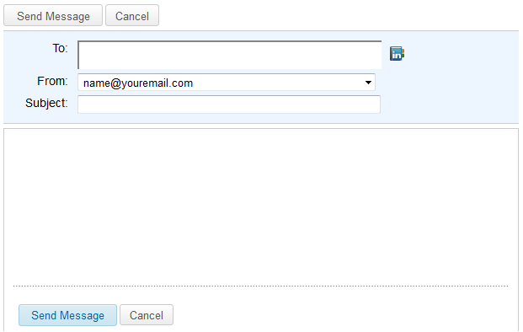
Tip’s for Messages and InMails
Send Messages or Inmails who matches to your criteria.
Ask for one thing at one time.
Keep your message short and to the point.
Use:
  Asking for help/Advice
  /Expertise
  Getting introductions
  Request to connect on LinkedIn

Slide 56
For Potential Candidates
Be Polite
Apologize for Direct Approach
Introduce Yourself
Don’t approach directly and talk about the vacancy you have in your first Inmail/Message.
E.g. Ask if he interested to listen to what you have or what is
he interested in etc.
Dear Name,
We have not spoken before but I am looking for your help on a project I am currently working on.
I know from your profile you have a well-developed network within the oil refinery market. I am looking for and General Manager to relocate to the Caribbean on an expat basis. Is there anyone you have worked with in the past who could be ready for this challenge?
If you have any questions or would like to recommend a colleague please let me know a convenient time and number to get in touch with you.
Kind Regards…
E
X
AM
P
L
E
S
Dear Name,
I am a specialist in upstream geology and seismic activities. I have been trying to reach you to have a discussion on activities in Development Geology so far I have been unable to reach you. I am retained by clients who are developing assets in Angola, Brazil, Mozambique, Morocco and Namibia. If this is interesting for you please advise on the best contact number for me to call and a convenient time to reach you.
Looking forward to your response,
Kind regards…
Dear Name,
I work with leading IT companies with a focus on placing senior IT professionals within challenging, unconventional projects worldwide.
After several weeks of research, I wanted to approach you regarding a specific opportunity on behalf of my client.
If you are open to an approach, please advise how best to contact you.
Best regards…

Slide 57





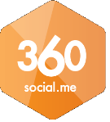

10 Things to do, before you use an InMail
Referral. See if there is someone you know that also knows them. (LinkedIn is also good for this)
Do a Google search for their name, they may have their own website or blog.
If you know where they work, it shouldn’t be too hard to find an email address for the person.
Do a Google search for their name and find which other social networks they are on.
Try using one of the Chrome Apps that show you people’s other digital presence. For E.g. Connect6, 360Social or Connectifier.

Slide 58





10 Things to do, before you use an InMail
See if they are on Google+
Message them via the social networks you find them on.
Search for them on Skype.
Do a graph search on Facebook to find them and message them directly.
Call them on the phone !

Slide 59
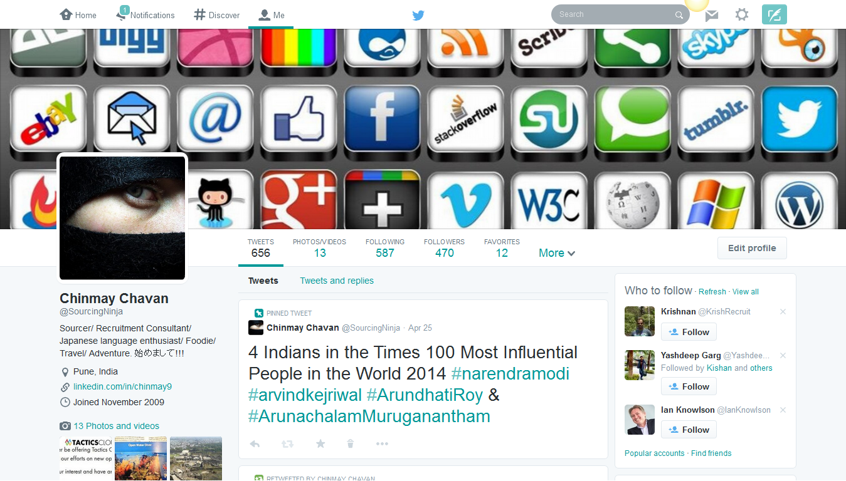
Bio
Top Line
Header Photo
Profile Pic
Twitter Bio

Slide 60
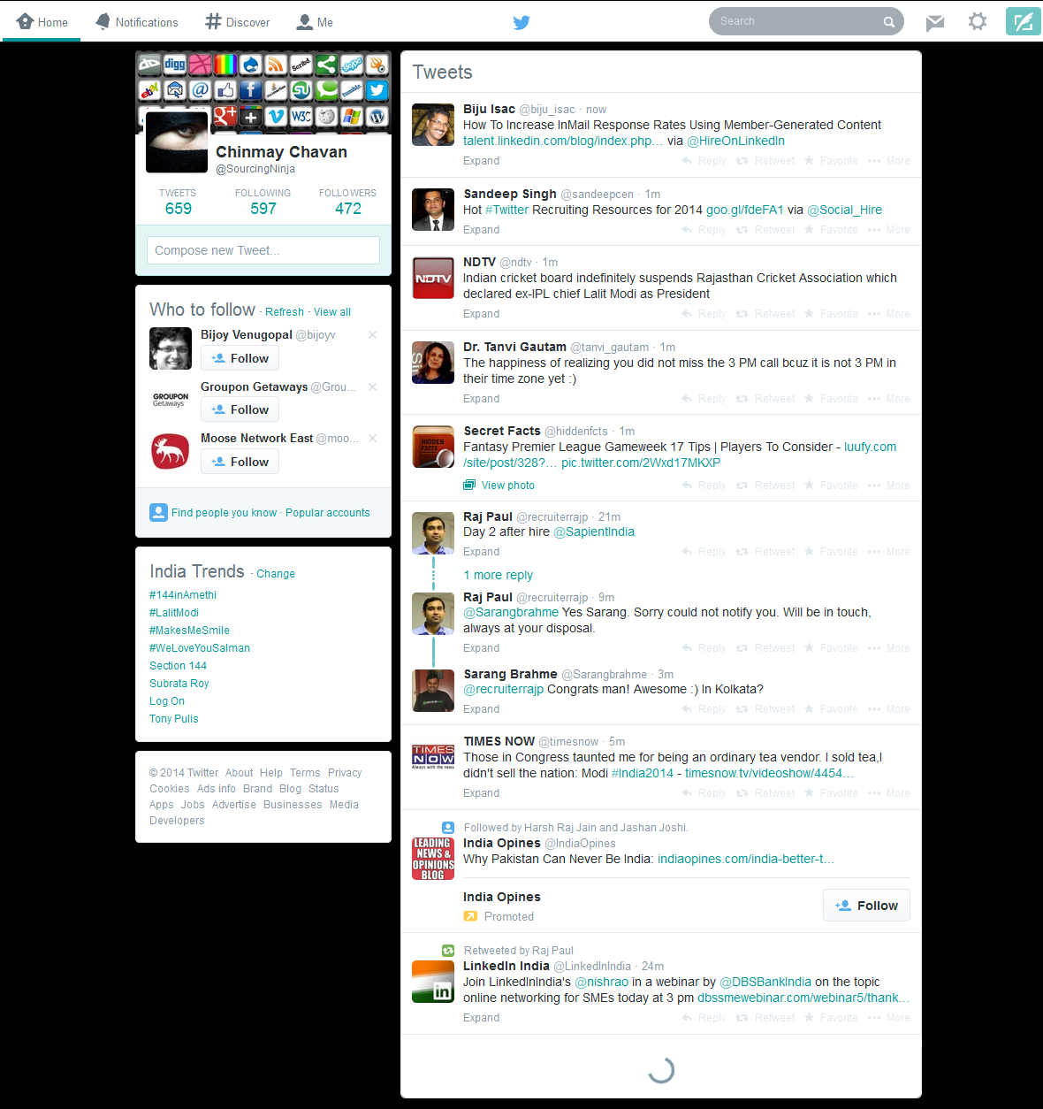
TimeLine

Slide 61
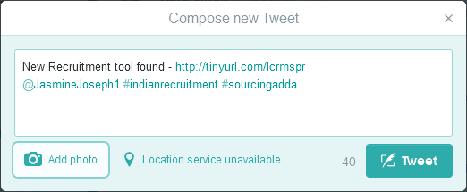
Tweets & Mentions
Tweet is a message sent on Twitter Network
140 Character Limitation
Mention Someone
Shorten Big URLs
Hashtag #

Slide 62
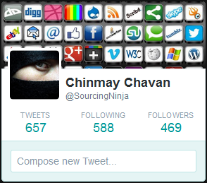
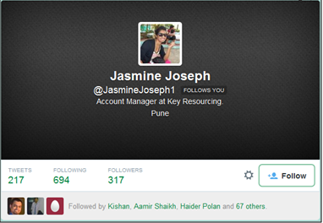
Following & Followers
Followers –
means people who receive updates (from the ones they follow)
Following –
means you will see their tweets

Slide 63
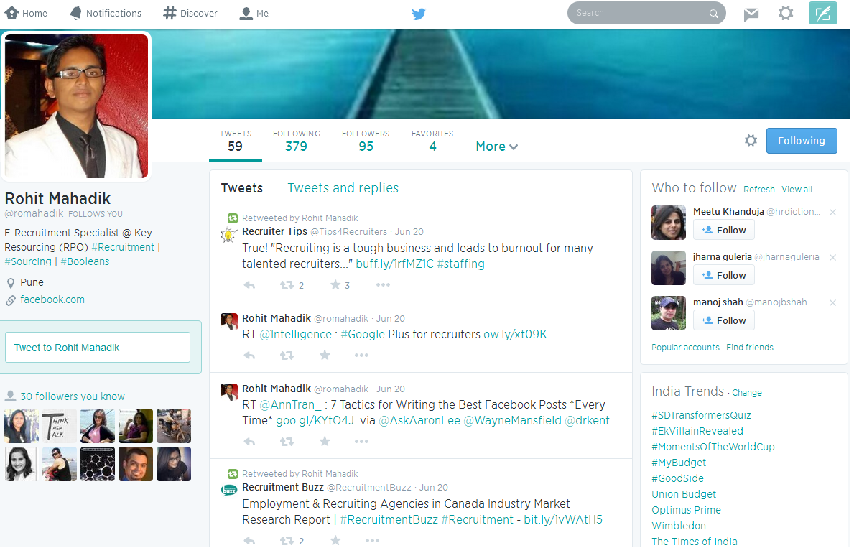
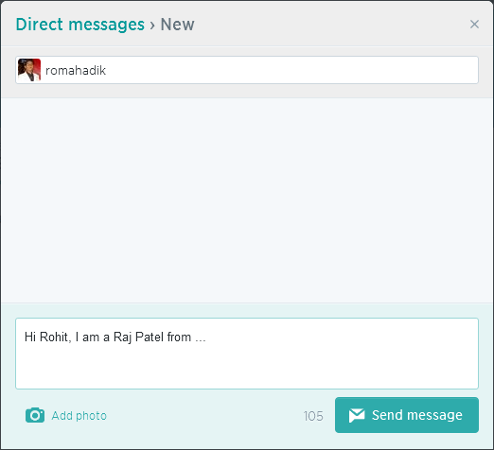
DMs – Direct Messages

Slide 64
Hashtag (#)
Use the hashtag symbol # before a relevant keyword or phrase (no spaces) in their Tweet to categorize those Tweets and help them show more easily in Twitter Search.
Clicking on a hashtagged word in any message shows you all other Tweets marked with that keyword.
Hashtags can occur anywhere in the Tweet – at the beginning, middle, or end.
If you Tweet with a hashtag on a public account, anyone who does a search for that hashtag may find your Tweet.

Slide 65

Find people on Twitter/People Search
Followerwonk
Acquired by SEOmoz In June 2012.
A tool for searching, filtering and managing Twitter bios with other Twitter management functions like analytics.
Along with searching the people of twitter you can compare them, Analyze, track and sort the Followers.

Slide 66
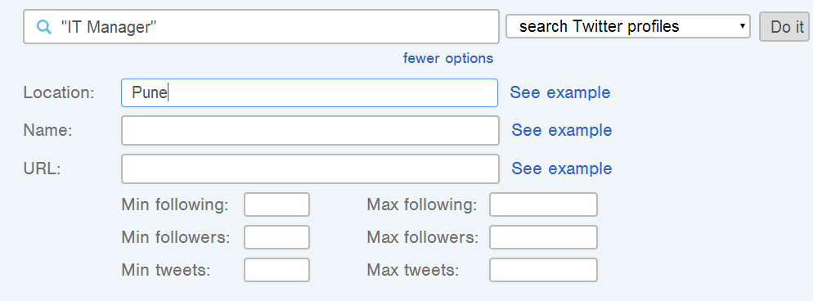
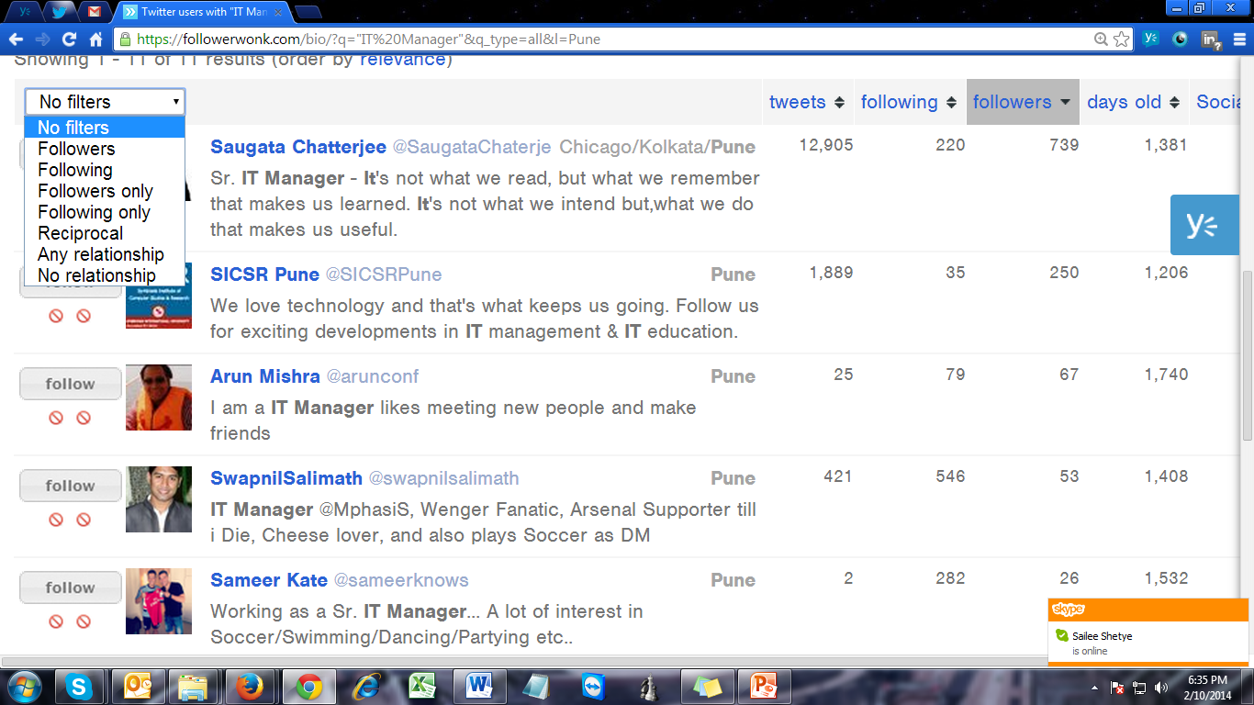
Multiple options in Search
Filter the results with the help of filter options

Slide 67
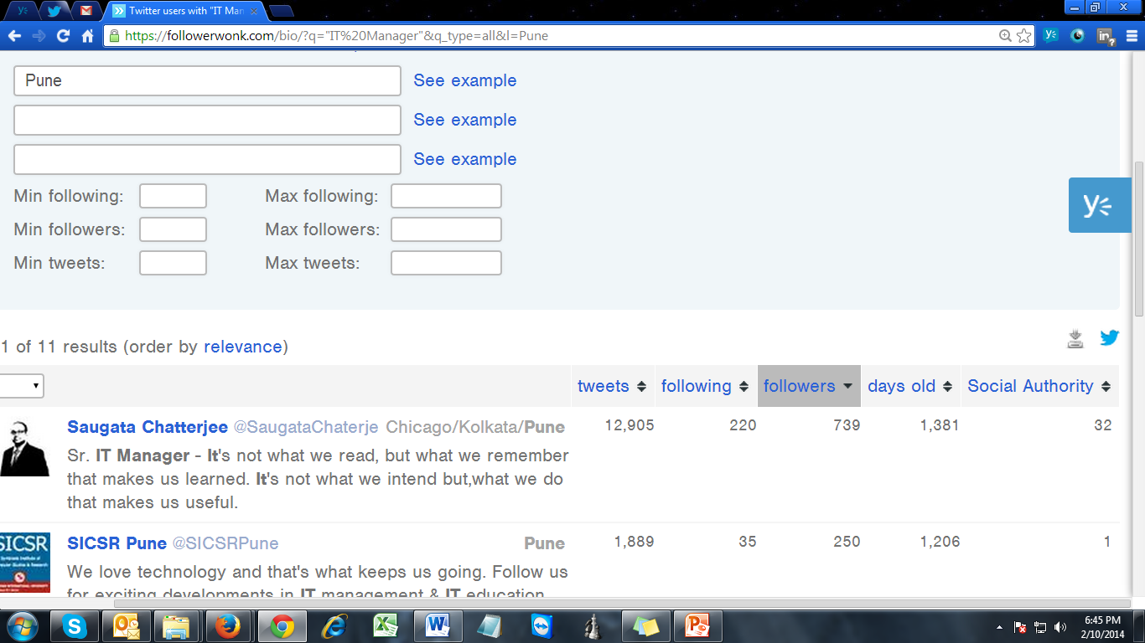
When performing a search will show a list of Twitter users who have the following data:
  Influence of the account.
  Number of Tweets.
  Number of people who follow.
  Number of followers you have.
  Days of the account is created.
You can sort your search results based on the above data.

Slide 68
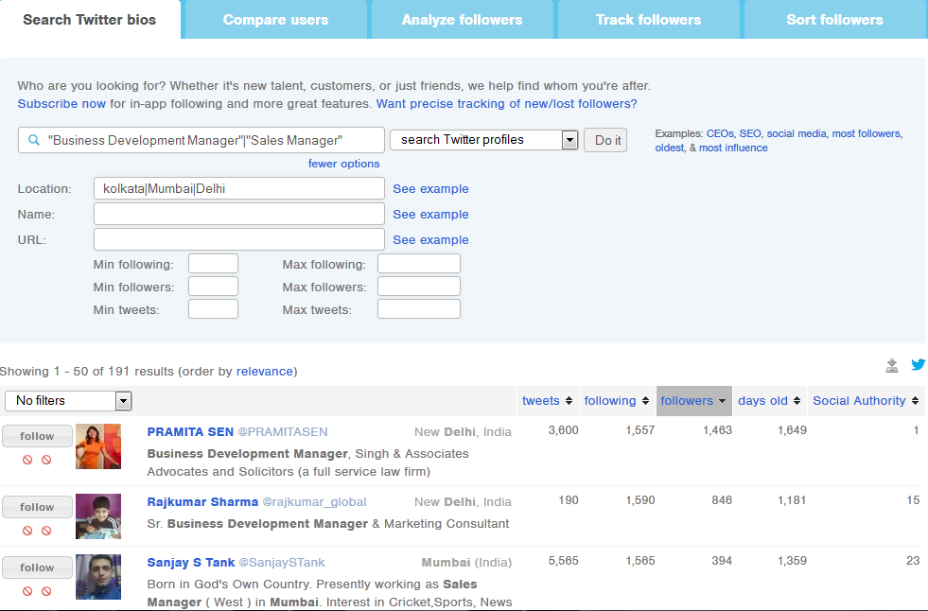
Find people on Twitter/People Search
Refine your search
Download as CV

Slide 69

Find people on Twitter/People Search
Tweepi
  for your bulk follow and unfollow
  Search for list and follow

Slide 70
Google Plus (Google+)
Social networking and identity service owned and operated by Google Inc.
Second-largest social networking site in the world
359+ Million active users

Slide 71
Some basics…
Follow for Pages and Add for People
"Circles" enable users to organize people into groups for sharing
"Hangouts" are places used to facilitate group video chat (with a maximum of 10 people
“Hashtags” (#) - beginning of a word or CamelCase, are hyperlinked to the most recent or highest-trending search results within Google+

Slide 72
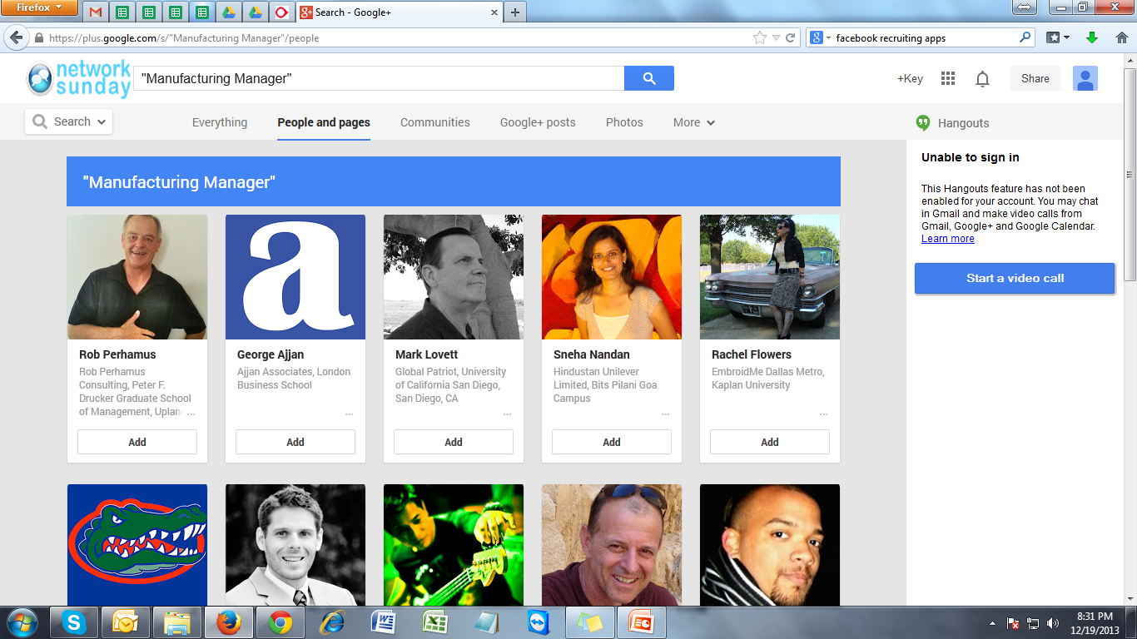
The “Official” Search on Google-Plus
Can search people, company, etc

Slide 73
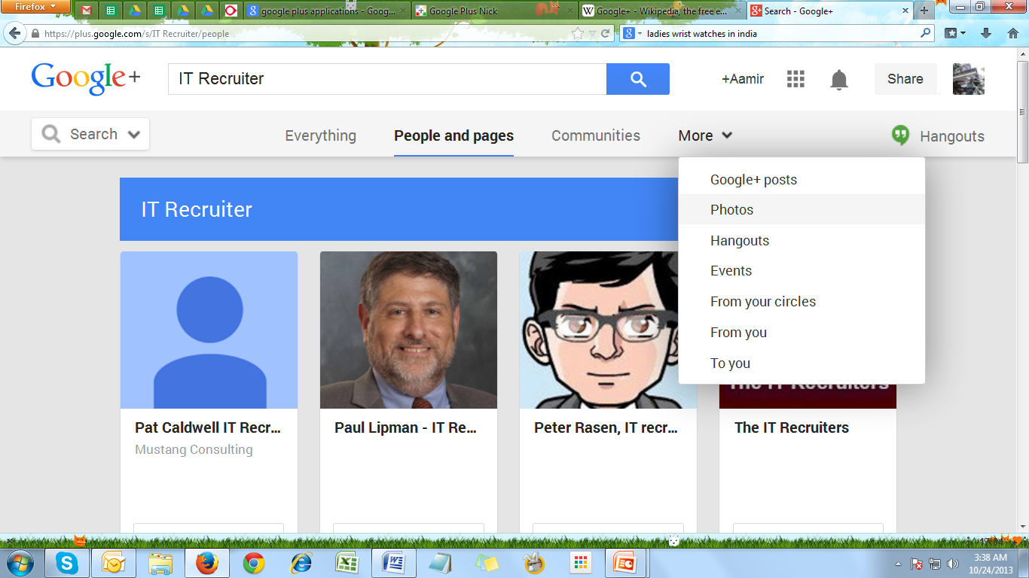
The “Official” Search on Google-Plus
Can take help of filters to narrow the search

Slide 74
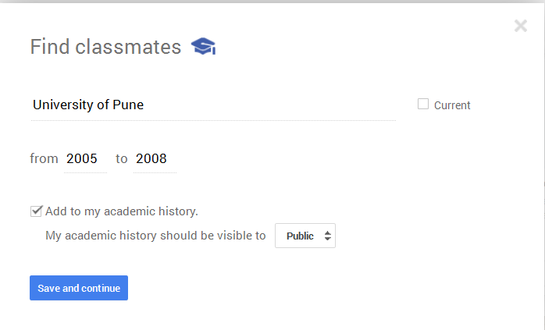
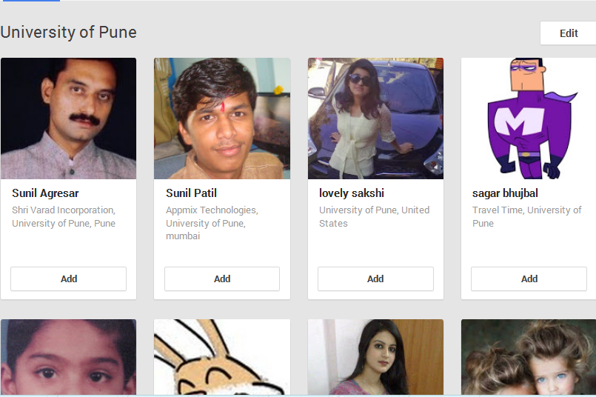
Can find classmates….
You can search for your classmates and follow them

Slide 75
Purpose focused Tools & Techniques
Now we will look at the Tools and Techniques other than the Social Platforms. There are many tools and techniques, which can help you to handle the social media and social recruiting and make it more productive for you.
  Social Media Monitoring Tools
  Tools to Enhance productivity
  Managing the Social Media
  Tools for Content Creation
Social Media Monitoring Tools | Tools to Enhance Productivity | Managing the Social Media | Tools for Content Creation
Social Mention | Dlvr.it | Social Flow | Scoop.it
BrandsEye | Buffer | SproutSocial | Storify
Brandwatch | SocialOomph | TweetDeck | Prezi
Hootsuite |  |  | Powtoon
 |  |  | Piktochart
 |  |  | Visme
 |  |  | Slideshare

Slide 76
Social Media Monitoring Tools
Tools | Description
Social Mention | Social Mention helps you learn about your brand mentions and interactionsin an easy-to-understand visual format. Sorted by timeframe or source you can find you brand‘s strength by knowing how often it is discussed, know how likely people repeat the mention, know about the related sentiment be it positive or negative, learn about the top keywords, hashtags, users and sources. Also you can get a RSS feed of your mentions to stay in the loop
BrandsEye | BrandsEye helps you manage and monitor your online reputation by finding all of your brand mentions, the reputation of their sources, it specifies the sentiment and also it has feature of flags for actions that may require immediate attention. With the help of this tool you can also get a performance and Return-on- Investment report on your social media campaign. BrandsEye has first crowd-sourced media insights provider making enable to evaluate and contextualize online mentions by people
Brandwatch | Brandwatch enables you to check the number of mentions your brand has across the internet and where are they coming from, as well as the reach of the comments. The tool gathers data staggering millions of sources including social networking platforms, blogs, forums, and news sites. The tool provides real time coverage of Twitter and is a Twitter Certified Product. It identifies and can deliver conversation in 27 languages, making it a very good tool to monitor your brand internationally. You also get the analyzed date and time information of the result.
Hootsuite | Hootsuite is considered as the easiest and most common brand- conversation monitor. It helps you to remain on the top in conversations in Facebook, LinkedIn and Twitter. You can schedule various social media posts and streamline the social networking.

Slide 77
  Social Tools to Enhance Productivity
Tools | Description
Dlvr.it | There are some social media activities that can be automated. The Dlvr.it tool helps you to automate the Blog Delivery on various social networking platforms. Simply by a specific source or channel from content comes and specifying the destination where you want the content to be published.
Buffer | Buffer helps you to schedule your different contents to be posted or published on various social media platforms on appropriate time. Strategically there are certain time periods when the particular content should be posted. Buffer helps you to do so and also make you assures about your content getting posted without fail. And hence increases the productivity regarding the social media handling.
SocialOomph | The tool SocialOomph is also called the ―Underdog of Twitter‖, it is named so because of its simple design yet powerful features. The tool takes care of Twitter profile‘s automation. The best part about the tool is that the developers keep updating the tool according to the new Twitter policies. The tool can also be used to influencers, tracking various keywords and monitoring the social media activities.

Slide 78
Managing the Social Media
Tools | Description
Social Flow | Social Flow offers services that can expand engagement and increases network. With the help of this tool, we can get and analysis of social signals to identify how much and where to have paid promotions, paid posts, promoted tweets, sponsored stories ,etc. And helping us reach extend the reach and engagement for Social Networking Platforms.
SproutSocial | Sprout Social offers a single stream inbox designed to manage the messages by collaborating and scheduling messages, tools to post seamlessly on various social media platforms. The tool has features of monitoring the social media activities and rich analytics to help you visualize important metrics.
TweetDeck | TweetDeck is owned by Twitter and hence focuses only on Twitter. The tool is available on internet for free. Whoever wants to start with only twitter accounts, then Tweetdeck is the best tool for them. The tool allows you to manage multiple twitter accounts. Also tweetdeck monitors and manages your twitter feeds with filters to focus on what matters.

Slide 79
Tools for Content Creation
Tools | Description
Scoop.it | Scoop.it is one of the most popular tools for content curation. It helps to discover, curate and publish the content to get its visibility online. The tool is excellent for publishing content online. You can also use the tool for branding.
Storify | Storify is a tool that allows the users to create stories or timelines using social media platforms like Facebook, Twitter, Instagram, etc. It creates stories or timelines related to particular subjects, events, discussions or hashtags from the various social media platforms. You can make them and share on different social platforms.
Prezi | Prezi is a tool that helps you convert your presentations into a snap. You can just browse the knowledge shared or create your own presentations. With the help of this tool you can also add animations. And share the content on various social media platforms.
Powtoon | Powtoon is a tool through which you can create videos or presentations in the form of video. You can use this tool in branding your company or in any other branding activity. These types of tools for content creation are trending on social media. But you need to understand your purpose and utilize.
Piktochart | With the help of this tool we can make infographics, images, brochures, charts and much more. Picktochart is an easy and user-friendly tool. You can create the required content on picktochart and save it on your pc or just directly share it to various social media platforms.
Visme | Visme is a tool that helps you to create various forms of visual content to drive engagement. You can create professional presentations, reports, info graphics, interactive demos, visual resumes and uch more. You can create different types of visual content, publish it and can share online. It is a great tool for recruiters as well as various businesses.
Slideshare | Slideshare is a tool by LinkedIn and is world‘s largest community for sharing presentations, PDFs, documents and other professional data or knowledge sharing data. Also you can create, upload and share on various social media platforms and share through email as well. If used appropriately it can help you reach and engage a large amount of social media users and hence the potential employees

Slide 80

Social Media Guide
Social Media Guide
What | Ask for Views, thoughts & share yours | Share your experience, blogs, Q&A | Ask Questions, Mentions, RT, Via, TChat
When | 3-4 Times a Day towards evening, more traction on weekends. | Once a day. Business Hours - Monday through Friday | Max 1 Tweet an Hour
How | 3-4 lines, Images, links, Videos | Slideshare, Publisher, Groups, Pictures, Video, | Shorthand, Symbols, Keep length to 120- 130 Char.
Images | More the better, convert text to image | Professional images | Share only self explanatory & relevant images

Slide 81
Social Network Profile
Customize public URL | Customize public URL | Bio with relevant handle
Join Groups & follow Company Pages | Join Groups & follow relevant Pages | Follow you target audience
Professional Picture & 100% Complete Profile | Add relevant URLs | Keep "About Section" updated & Complete
Open Networker | Manage Security Settings | Follow & use #tags

Slide 82
Social Network Activity
Open to recruitment communication | Would like to know about you & your company | DM any recruitment message
Post Jobs in Relevant Groups | Route them to your Company page | Share Jobs but tweets must be relevant & interesting for target audience.
Status Updates must be professional | Give it a personal touch | As per target audience.

Slide 83
Strategies for hiring through social media
Social Recruiter‘s Professional Process Expertise
Branding Strategies
Online-Offline Integration Strategies

Slide 84
Social Recruiter‘s Professional Process Expertise
Sourcing
-Internal and external job postings
Screening
- Narrowing Down Promising Candidates
Selection
-Phone screening
-Interviewing
-Interview Preparation
-Questions and Scripting
-Questions to Pose During Interviews
Follow-up
-Thank-you‖ email making it easy for you to follow-up.
-Check up on the references that they have provided.
- Reference checking is usually the most overlooked area of recruitment.
-Some employers also conduct drug screenings, criminal background checks, immigration status and legality checks as a part of their screening process.
On-boarding
-A welcoming walk-through
-An effective learning schedule
-Setting up necessary facilities
-Involving other team members
-Use of appropriate media to advertise open positions
-Searching online database and job portals
-Classified ads in local and regional newspapers
-Hiring specialist recruitment consultants
-Publishing job postings in trade journals (e.g. Pharma)
-Collaborating with recruitment agencies
-Local and regional hiring drives
-Grassroots efforts such as college job fairs and student interviews
-Paper Screening
-Establishing Connection
-Sample Interview Questions
-Use non-verbal cues
-After the Interview
-Moral of the story

Slide 85



Branding Strategies
Employer Branding
Build an attractive proposition
Candidate Branding
Package Yourself Well
Social Recruiter Branding
Build Your Recruiter Brand
Keep it real
Build culturally from inside-out
Conduct rigorous internal marketing
Highlight Your Selling Points
Give Yourself an Edge
Use Word-Of-Mouth
Recruiter’s Value Proposition
Marketing Your Recruitment Brand
Set Yourself Apart

Slide 86
Online-Offline Integration Strategies
Integration will be the key to succeeding in tomorrow's social savvy world. Social media can be an endlessly time-consuming activity, or it could be a blessing and a time saver for busy recruiters if used efficiently and effectively. Recruiters have forever been talking about leveraging social media for hiring purposes using online- offline integration but how does one leverage and integrate into real life recruiting situations?
Over the last decade, mobile recruitment processes have made the sourcing, screening, hiring and on-boarding of candidates much faster and more efficient
Develop Solid Content Marketing Strategies
  Using the Right Software for Sourcing, Screening and Profiling Candidates
  Also, what about professional organisations and associations?
  Use smart sourcing strategies
  Create the right partnershipsUsing
  Use Online and Temporary Staffing Strategies
  E-Staffing

Slide 87
Social Recruiting Success Stories

Slide 88
Sr. No. | Name | Platform | Work Profile | Link
1 | Manish Chandra Gupta | LinkedIn | Senior LinkedIn Recruiter – Global at Orange Business Services | https://www.linkedin.com/in/manishcgupta/
2 | Radhika Chandan | LinkedIn | Candidate Development Recruiter – India & APJ at VMware | https://www.linkedin.com/in/radhika-chandan-25908615/
3 | Priyanka Rishi | LinkedIn | Talent Research Analyst at McKinsey Solutions | https://www.linkedin.com/in/prishi/
4 | Tripti Pathak Tripathi | LinkedIn | Recruitment at Genpact | https://www.linkedin.com/in/triptimanitripathi/
5 | Abhinav Sharma | LinkedIn | LinkedIn Recruitment Expert – Global at Orange Business Services | https://www.linkedin.com/in/abhinavsharma7/
6 | Kevin Silvestre @cali_kev63 | Twitter | Human Resources professional within the hospital and healthcare system in the Bay Area of San Francisco. | https://twitter.com/cali_kev63?lang=en
7 | Jason Buss @jjbuss | Twitter | Creator and editor at Talent HQ, an online news and information channel for the recruiting and human resources community | https://twitter.com/jjbuss?lang=en
8 | Harry Urschel @eExecutives | Twitter | Executive Recruiter, job search coach and writer with over 25 years of career development experience. Founder of executive search firm called e-Executives. Currently working at Minneapolis Practice Leader for the search practice of Baker Tilly. | https://twitter.com/eexecutives?lang=en
9 | Jeremy Roberts, SPHR @imJeremyR | Twitter | Vice President, Customer Experience at HiringSolved. | https://twitter.com/imJeremyR
10 | Craig Fisher @fishdogs | Twitter | Marketing / Employer Branding Leader at Allegis Global Solutions RPO, Keynote Speaker, Founder Linkedin Training Dallas | https://twitter.com/Fishdogs?ref_src=twsrc%5Egoogle%7Ctwcamp%5Eserp%7Ctwgr%5Eauthor

Slide 89
11 | Amy Chism @AmyChismuk | Twitter | Social Media Jobs Coach & Expert for Online Recruiting | https://twitter.com/AmyChismuk?ref_src=twsrc%5Egoogle%7Ctwcamp%5Eserp%7Ctwgr%5Eauthor
12 | Graham Jenkins @grahamjenkins | Twitter | Executive Search Specialist, Board Director & Mentor to CEOs and Senior Executives | https://twitter.com/grahamjenkins
13 | Jessica Merrell, SPHR @jmillermerrell | Twitter | Chief Innovation Officer, Workology | https://twitter.com/jmillermerrell?lang=en
14 | Sean Smith (Late) @seansmithlegal | Twitter | Criminal Defence Enabler at Criminal legal defence, Legal Industry & Recruitment Socila Media Influencer | https://twitter.com/seansmithlegal?lang=en
15 | Axel Koster @axelkoster | Twitter | Chief Strategy Officer – Recruitment, Digital Marketing & Alliance Program at Manhattan Group | https://twitter.com/axelkoster?lang=en
16 | Tony Restell @tonyrestell | Twitter | Director at Social Hire.com | https://twitter.com/tonyrestell?lang=en
17 | Jim Stroud @jimstroud | Twitter | RPO SR Recruitment Strategies & Support Director at Randstad Source right US | https://twitter.com/jimstroud?ref_src=twsrc%5Egoogle%7Ctwcamp%5Eserp%7Ctwgr%5Eauthor
18 | Glen Cathey @GlenCathey | Twitter | SVP Talent Acquisition Strategy and Innovation at Kforce | https://twitter.com/GlenCathey?ref_src=twsrc%5Egoogle%7Ctwcamp%5Eserp%7Ctwgr%5Eauthor
19 | Stacy Donovan Zapar @StacyZapar | Twitter | Founder & Principal Strategist at Tenfold | https://twitter.com/StacyZapar?ref_src=twsrc%5Egoogle%7Ctwcamp%5Eserp%7Ctwgr%5Eauthor
20 | Bill Boorman @BillBoorman | Twitter | Managing Director – Technology & Innovation at RecruitingDaily.com | https://twitter.com/billboorman?lang=en

Slide 90
21 | Steve Levy @LevyRecruits | Twitter | Principal: Recruiting, Talent, and Social Media Consultant at Recruiting Inferno Consulting. | https://twitter.com/levyrecruits?lang=en
22 | Andy Headworth @andyheadworth | Twitter | Managing Director of Sirona Consulting Ltd | https://twitter.com/andyheadworth?ref_src=twsrc%5Egoogle%7Ctwcamp%5Eserp%7Ctwgr%5Eauthor
23 | Johnny Campbell @JohnnyCampbell | Twitter | CEO and co-founder at Social Talent | https://twitter.com/johnnycampbell?lang=en
24 | Matt Alder @mattalder | Twitter | Digital, Social and Mobile Marketing Strategist at MetaShift | https://twitter.com/mattalder?ref_src=twsrc%5Egoogle%7Ctwcamp%5Eserp%7Ctwgr%5Eauthor
25 | Mervyn Dinnen @MervynDinnen | Twitter | Talent Acquisition Analyst at Talent Insight | https://twitter.com/mervyndinnen?lang=en
26 | Katrina Collier @WinningImpress | Twitter | Social Media Recruitment Trainer at Winning Impression | https://twitter.com/winningimpress?lang=en
27 | Joe Burridge @JoeFindsTalent | Twitter | Tech Recruiter at Hudl Social Media Addict | https://twitter.com/joefindstalent?lang=en
28 | Steve Boese @SteveBoese | Twitter | HR Technology Conference Co-Chair, Co-Host of the HR Happy Hour Show | https://twitter.com/SteveBoese?ref_src=twsrc%5Egoogle%7Ctwcamp%5Eserp%7Ctwgr%5Eauthor
29 | Will Staney @willstaney | Twitter | Founder & Principal of ProactiveTalent | https://twitter.com/willstaney?ref_src=twsrc%5Egoogle%7Ctwcamp%5Eserp%7Ctwgr%5Eauthor
30 | Greg Savage @greg_savage | Twitter | Founder of Recruitment Solutions, Firebrand Talent | https://twitter.com/greg_savage?lang=en

Slide 91
31 | Michael Hyatt | Facebook | Author, speaker, blogger & podcaster. | https://www.facebook.com/michaelhyatt?fref=pb&hc_location=profile_browser
32 | Chalene Johnson | Facebook | Motivational speaker & author. | https://www.facebook.com/pg/chalene/about/?ref=page_internal
33 | Ted Rubin | Facebook | Social media strategist & speaker. | https://www.facebook.com/tedrubin?fref=ts&ref=br_tf
34 | Sue B. Zimmerman | Facebook | Instagram marketing expert. | https://www.facebook.com/SuebZimmermanEnterprise
35 | Mari Smith | Facebook | Forbes Top Social Media Power Influencer & Facebook marketing expert. | https://www.facebook.com/marismith
36 | Kim Garst | Facebook | Forbes Top 10 Women Social Media Influencer & CEO of Boom Social | https://www.facebook.com/kimgarst
37 | Chris Brogan | Facebook | Publisher & CEO of Owner Magazine | https://www.facebook.com/broganchris?fref=ts
38 | Melonie Dodaro | Facebook | LinkedIn expert & social media trainer. | https://www.facebook.com/meloniedodaro?fref=ts
39 | Viveka von Rosen | Facebook | LinkedIn expert & speaker | https://www.facebook.com/vivekavonrosen?fref=ts
40 | Sandi Krakowski | Facebook | Facebook expert & Forbes Top 20 Social Influencer | https://www.facebook.com/SandiKrakowskiBiz

Slide 92
41 | PewDiePie | Facebook | PewDiePie has one of the most popular YouTube channels in the world. | https://www.facebook.com/PewDiePie
42 | Paul Carrick Brunson | Facebook | writer & entrepreneur | https://www.facebook.com/PaulCBrunson
43 | Guy Kawasaki | Facebook | Guy is chief evangelist at Canva | https://www.facebook.com/PaulCBrunson
44 | Social Tribe | Facebook | Social Tribe is a San Francisco-based social engagement agency | https://www.facebook.com/socltribe
45 | Nichole Kelly | Facebook | CEO at Social Media Explorer | https://www.facebook.com/NicholeKellyRocks?fref=ts&ref=br_tf
46 | Socially Sorted | Facebook | Donna Mortiz helps businesses, entrepreneurs & bloggers get more reach. | https://www.facebook.com/sociallysorted
47 | Tony Robbins | Facebook | Entrepreneur, author & speaker | https://www.facebook.com/TonyRobbins
48 | Social Media Examiner | Facebook | Social Media Examiner is one of the largest social media publications in the world | https://www.facebook.com/smexaminer
49 | Brendon Burchard | Facebook | Best-selling author & motivation speaker | https://www.facebook.com/brendon.burchard.714
50 | Robin Sharma | Facebook | social entrepreneur & author | https://www.facebook.com/RobinSharmaOfficial/
51 | Ann Tran | Facebook | Forbes top 10 social media influencer | https://www.facebook.com/AnnTranSocial?fref=ts

Slide 93


BIG
CONTACT
US

